Slide 1

How to Synthesize
Graduate Student Success Center

Slide 2
What is Synthesis?
The integration of more than one source for the support of one idea/thesis
Hinges on your ability to uncover relationships between sources
Purpose of Synthesis
Explanatory - seeks to give an overview of literature on a particular subject
Argumentative - uses information from multiple sources to support a thesis

Slide 3
Types of Synthesis
Similarity - how two or more sources agree with one another
Contrast - how two or more sources support an idea in different ways
Accumulation - how one source continues or builds on another
Causation - how one sources deals with the ramifications or ideas of another source

Slide 4
Synthesizing Sources
Determine your purpose
Choose and read a multitude of sources
Create a thesis
Reread your sources with your thesis in mind
Create a Synthesis Matrix (highlight and annotate accordingly)
Read one more time for good measure

Slide 5
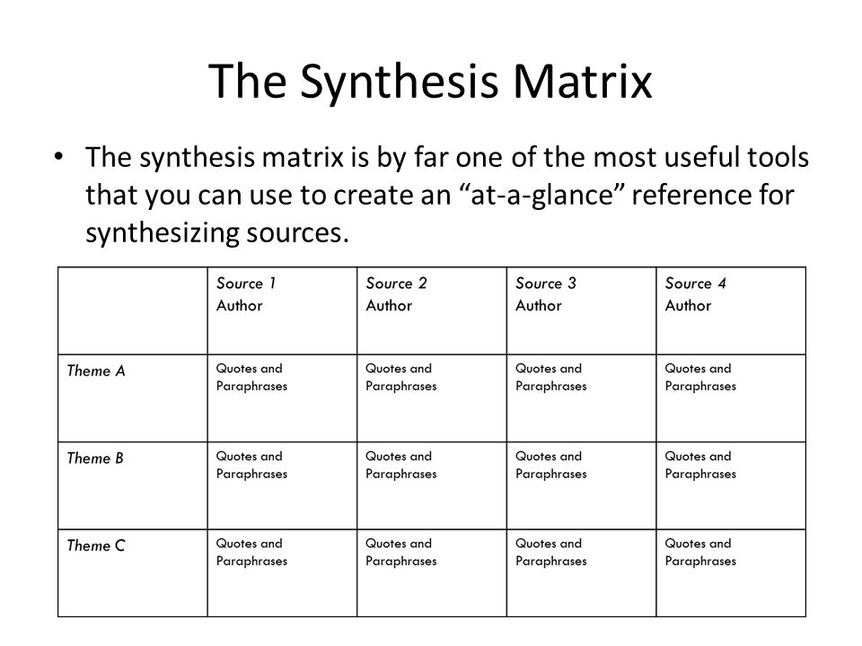

Slide 6
Organizing Your Paper
Good organization begins with a strong sense of purpose
Types of organization
Sub topic or concept
Methodology

Slide 7
Components of a Synthesis Paragraph
A well thought out topic sentence that EXPLICITLY connects to your thesis
Information from more than one source, showing how these sources relate to one another and the topic/thesis (with correct in text citations)
Strong and accurate attribution verbs
Well thought out transitions between sources
Transition to the next paragraph

Slide 8
Common Pitfalls
Synthesis is NOT summary
Overusing direct quotations
Introduce the quote, give adequate context, and explain why the quotes importance
No transitions
Incorrect in-text citations
Not portraying sources accurately

Slide 9
Sources
https://www.uis.edu/ctl/wp-content/uploads/sites/76/2013/03/Synthesizingresearch.pdf.pdf
https://msu.edu/~jdowell/135/Synthesis.html
https://users.drew.edu/sjamieso/synthesis.html
https://guides.library.jhu.edu/ld.php?content_id=16149009

